Slide 1



How Carrier is helping
bridge the tech gap and
empower the next generation
of HVAC technicians.

Slide 2


As long as there are homes and
businesses that need heating and cooling, there will be a need for HVAC technicians. Today, that need is stronger than ever.
We live in a world where technologies and industries are rapidly changing,
and the HVAC trade is no exception.

Slide 3


Unfortunately, fewer young people today
are even aware of the HVAC profession,
leaving dealers with a severe – and
growing – shortage of technicians to sell
and service their equipment.
409,309*
Estimated number of skilled techs
needed to fill gaps left by retiring
techs over the next decade.
* www.wearegenerationt.com

Slide 4


By educating young people about the
many benefits of a career in the HVAC
trade, we can play a big role in helping
our industry bridge the tech gap and serve
as leaders for the next generation
of technicians.
College debt fact
$37,172*
Average student debt in 2017
* www.chamberofcommerce.org/student-loan-statistics

Slide 5


Tech Up is our initiative to get the word out
to young men and women, their parents and
school administrators that a career in HVAC
is a secure, lucrative and satisfying endeavor –
and the chance to apply their tech skills in
hands-on applications.
Through digital, social and printed resources, including a program landing page, Tech Up
tackles common misperceptions about the
industry and raises awareness of the benefits of
an HVAC career, giving dealers and educators
the tools they need to encourage these young
adults to become part of a proud profession.

Slide 6


We’re targeting high schoolers and young adults.
Through focused research, we know our audience is looking for careers that offer:
A good salary and stable employment
Variety within day-to-day routine and tasks
The ability to leverage emerging
technologies and digital tools
The opportunity to use math, science
and problem-solving skills
The chance to move up through the
ranks with experience
We’ve also tailored these messages in materials developed for parents and school educators.

Slide 7

Key Program Messages
Many companies
will pay you while you learn on the job.
2018 median pay was over $47K/year* with the chance
to earn more.
Most employers
offer paid vacation, healthcare benefits and 401(k).
Learn new
skills with virtual- reality training and digital apps.
You’ll have the chance to move up as you learn and progress.
* https://www.bls.gov/ooh/installation-maintenance-and-repair/heating-air-conditioning-and-refrigeration-mechanics-and-installers.htm#tab-5

Slide 8
What Carrier is doing to help
We’ll be supporting our channel partners every step of
the way, doing our part by facilitating leads, providing
scholarships for training, making co-op funds available
for Tech Up advertising and more.

Slide 9
Dealer and Distributor materials
Education materials
Open House program
Job Fair program
Landing page

Slide 10


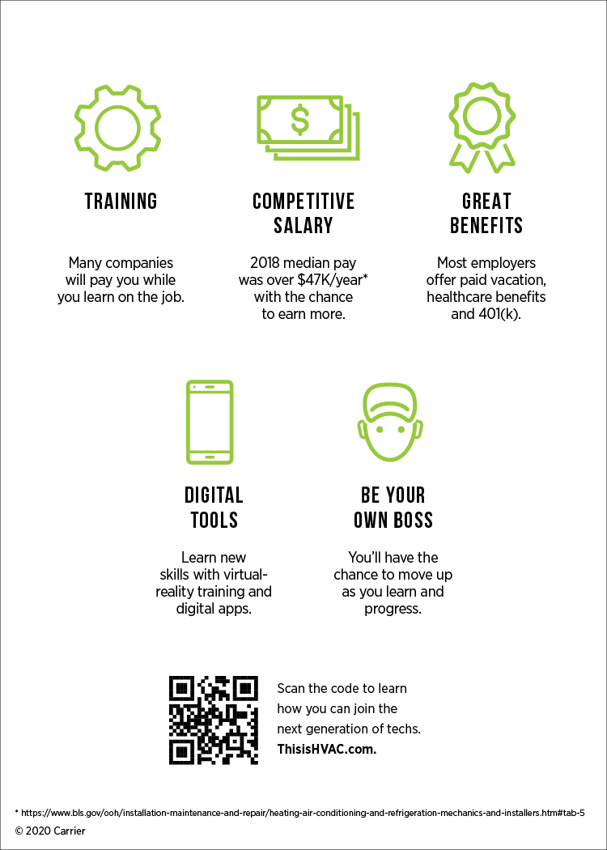
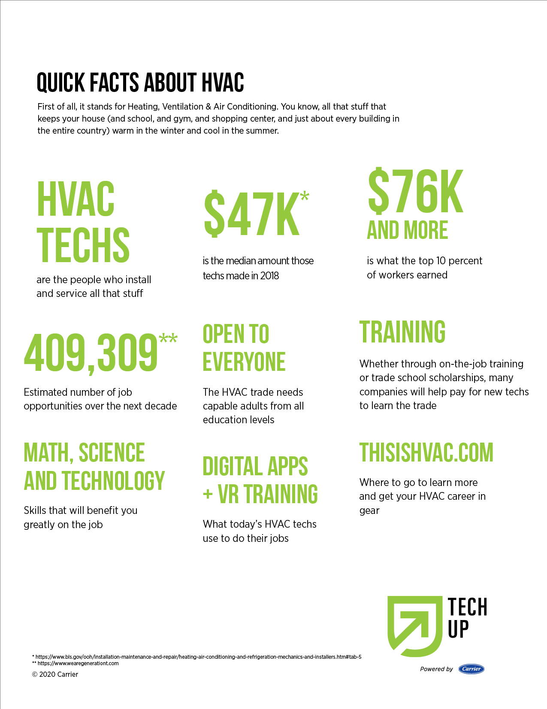
Education Materials
Parent Brochure
Student Card
Fact Sheet

Slide 11

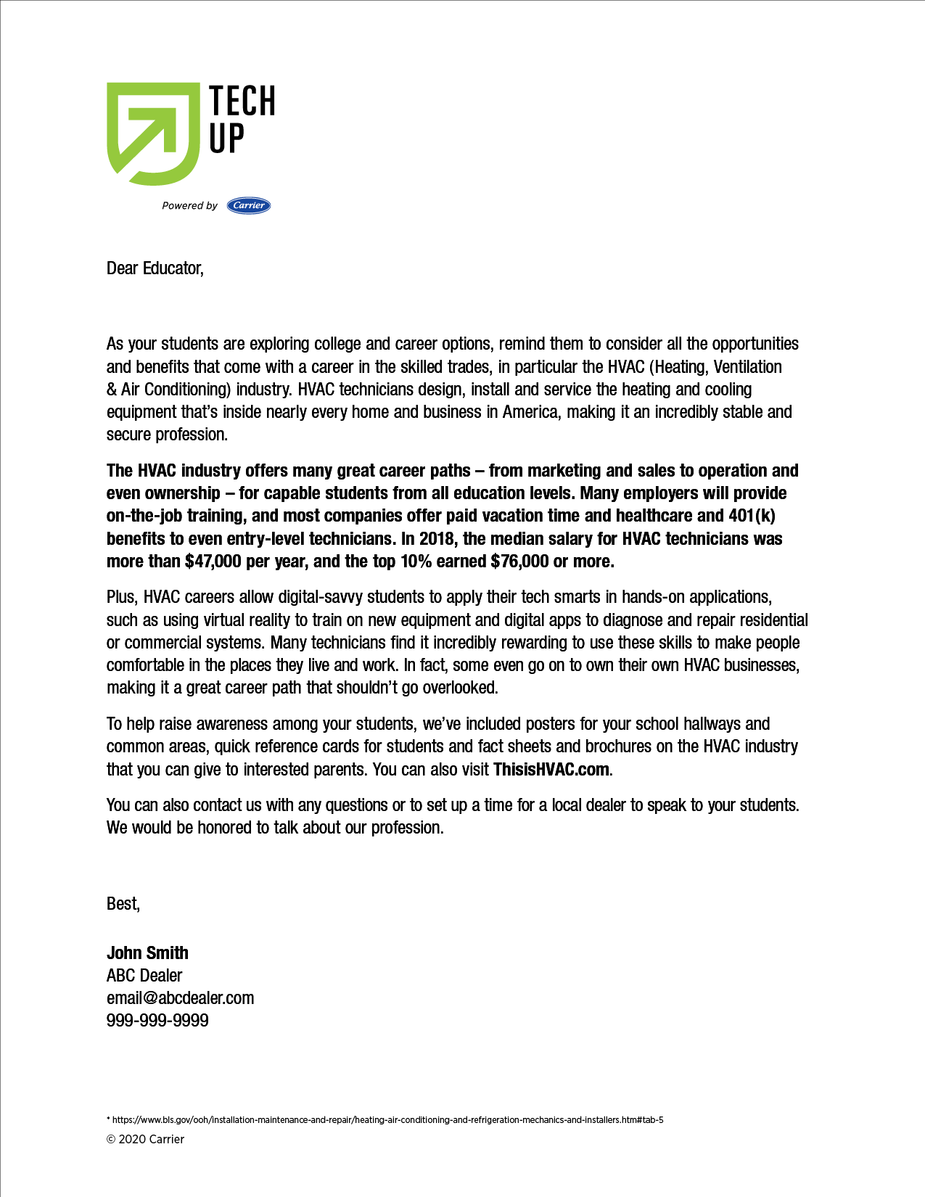
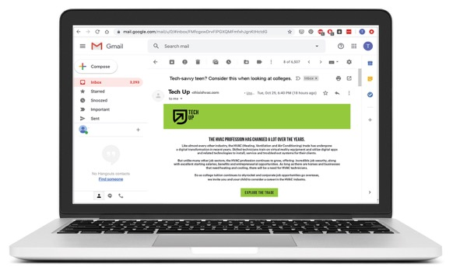
Education Materials
Sticker for Donuts or Pizza Box
Parent Email
School Letter

Slide 12

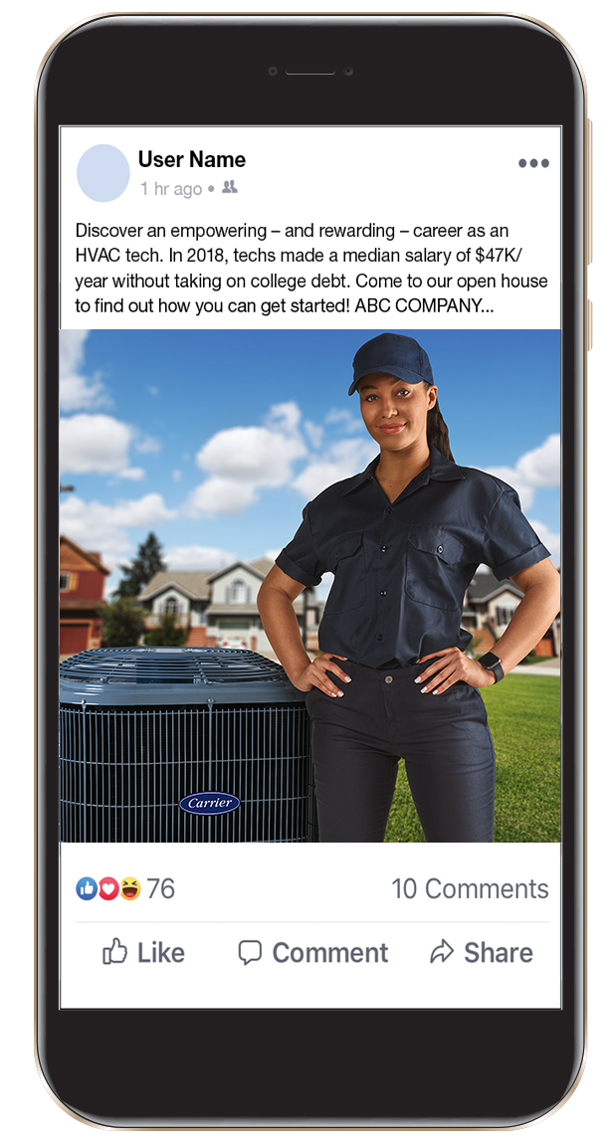
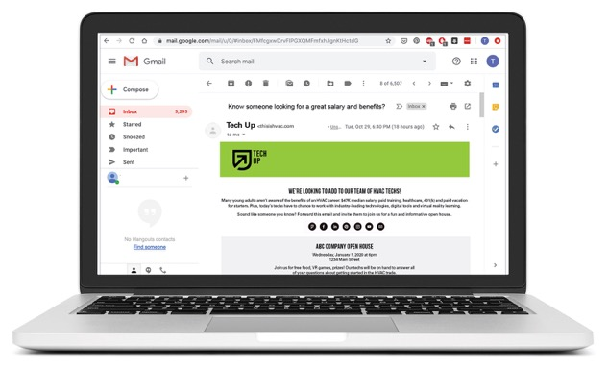
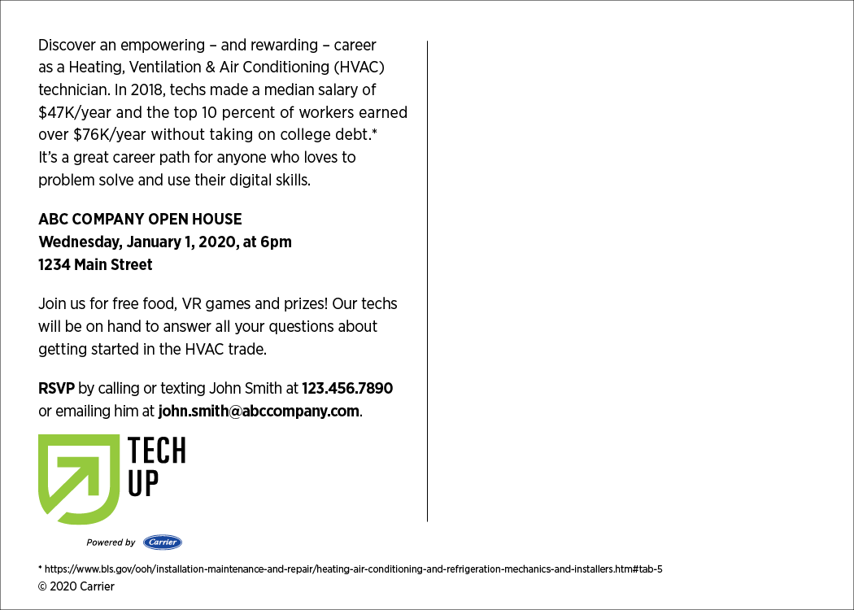

Open House Kit – Promoting event
Invite Postcard
Social Post
Invite Email
Radio Spot

Slide 13








Open House Kit – On-site materials
Hat
PPT
Video
Buttons
VR Training Module
Pull-up Banner
Tablecloth
T-shirt

Slide 14
Job Fair
Hat
PPT
Video
Buttons
VR Training Module
Pull-up Banner
Tablecloth
T-shirt

Slide 15
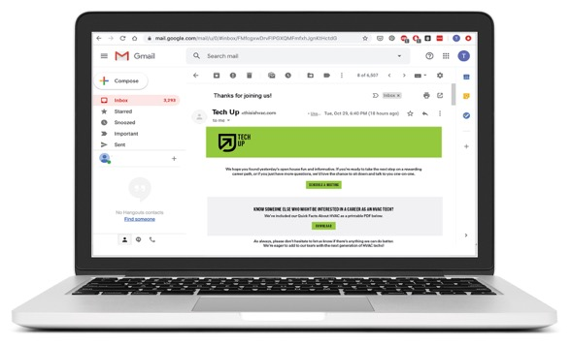


Job Fair
Follow-up Email
Posters
Fact Sheet

Slide 16


Consumer landing page
Program overview
Tech comments
Job leads
Downloads

